Slide 1
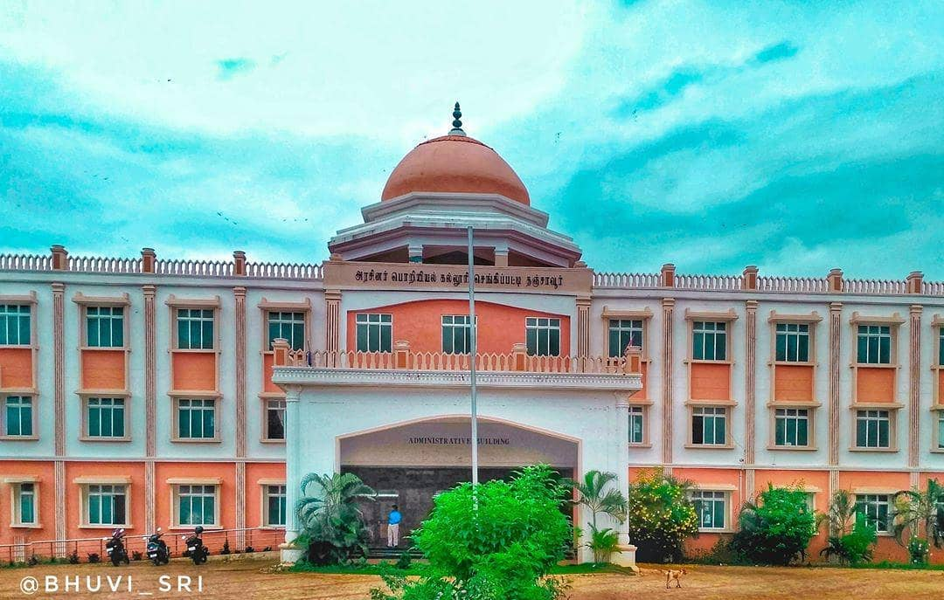





GOVERNMENT COLLEGE OF ENGINEERING - THANJAVUR
DEPARTMENT OF ELECTRONICS & COMMUNICATION ENGINEERING
Staff co-ordinator:
Mr.A.Dinesh M.E AP
Mr. Ashokan M.E Ph.D. AP
+91 98941 73017
http://www.gcetj.edu.in/
Student co-Ordinator:
Mullai Arun G
adinesh@gcetj.edu.in
https://bit.ly/2ZvDCas

Slide 2
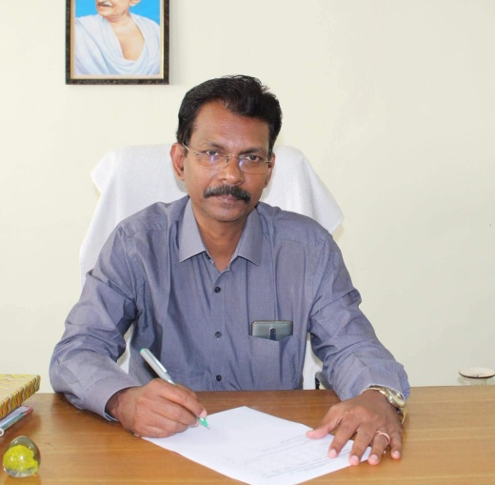
PRINCIPAL
Dr . R . Vijayan
Government College of Engineering, Thanjavur was established in the year 2013 by Government of Tamil Nadu to cater to the needs of technical education in emerging areas of engineering and excellence in research in different disciplines of science and engineering.
The Tamil Nadu Government has created adequate infrastructural facilities and sufficient funds and is keen on developing the institute for higher education. The college has been located on 35.73 acres, 20 km from the city of Thanjavur and 35 km from the city of Trichy on Sengipatti - Gandharvakottai Main road.
65 % pass percentage has been achieved by the student in past two academic years. Around 1000 students are studying in this institution, 200 students are belonging to Electronics & communication engineering discipline.

Slide 3
ABOUT
THE DEPARTMENT
Electronics and communication Engineering is the one of the major discipline in the engineering profession and its principles are involved in the design, study, development and construction of nearby all of the physical devices and system to help the mankind. It is One of the founding department of Government College of Engineering(GCE)sengipatti, Thanjavur. Today the department of Electronics and communication Engineering GCE attracts and features an extraordinary and rich diversity and quantity of talented individuals, with 11 faculty members (50% of staff with Ph.D qualification).

Slide 4
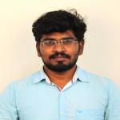
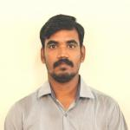
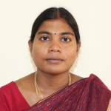
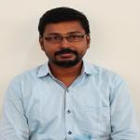
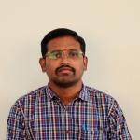
DEPARTMENT FACULTIES
Mr. R Ramji M.E
(Assistant Professor)
Mr. K Manikandan M.E
(Assistant Professor)
Mrs. K Renugadevi M.E
(Assistant Professor)
Mr. A Dinesh M.E
(Assistant Professor)
Mrs. G R Anushakumar M.E
(Assistant Professor)

Slide 5
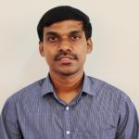
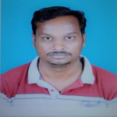
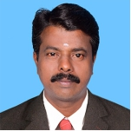
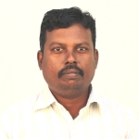
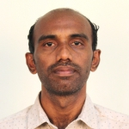
STAFFS
OF THE DEPARTMENT
Mr. S KULOTHUNGAN M.Tech
(Assistant Professor)
Dr. S Mohan M.E.
(Assistant Professor)
Dr. M Selvakumar M.E.,MBA.
(Assistant Professor)
Dr. A Ashokan M.E.,Ph.D.
(Assistant Professor)
Mr. D Balakumar M.E
(Assistant Professor)

Slide 6




STUDENT STRENGTH
2nd year : 18
3rd year : 26
45%
4th year : 35
BOYS
GIRLS
55%
2nd year : 44
3rd year : 26
4th year : 25

Slide 7






CURRICULAM
COMMUNICATION SYSTEM
Analog systems
Digital communications
Communication networks
Wireless networks
PROCESSOR
ARM7-LPC2148
8086-8051
DSP-TMS320541X
FPGA,CPLD
SOFTWARE
PSPICE ,MASM,MATLAB,XILINX ISE, IAR EMBEDDED WORKBENCH,
LANGUAGE-VERILOG,VHDL ,Embedded C
DESIGN ENGINEERING
CIRCUITS DESIGN
DIGITAL DESIGN
VLSI DESIGN
EMBEDDED SYSTEM DESIGN
TRANSMISSION LINES
EMF, Transmission lines and wave guide, antenna and RF microwave

Slide 8


CO-CURICULAR ACTIVITIES
The Department of Electronics and communication Engineering has been organized one day workshop in Arduino on 20th September 2016
The Department of Electronics and communication Engineering has been conducted the workshop on “Computer Assembing, Troubleshooting and Networks” from 20th September to 23rd September and from 29th September to 02 October 2018 and completed Successfully
ICT Academy of Tamil Nadu along with the support of IT Department Government of Tamil Nadu & TNSDC had initiated the training for 2014-2018 batch final year ECE and CSE Students in “Soft Skills& IT/ITES Sector” and it was conducted for 150 hrs from 17.08.2017 to 15.09.2017 at our Institution and was successfully completed.

Slide 9
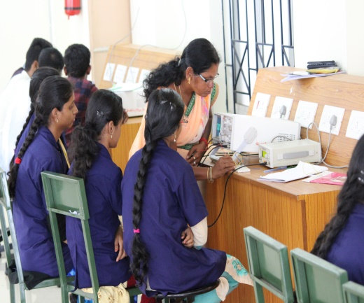
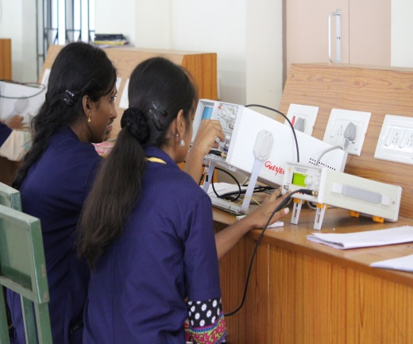
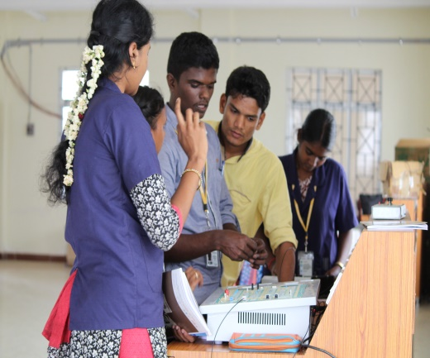
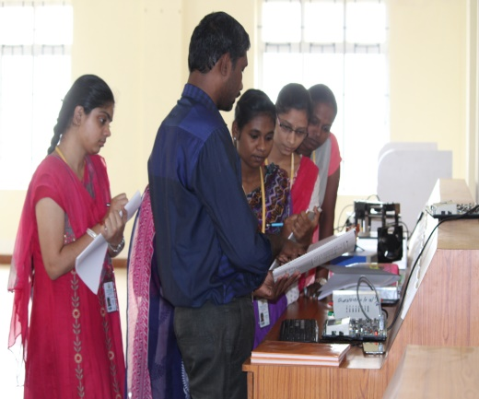
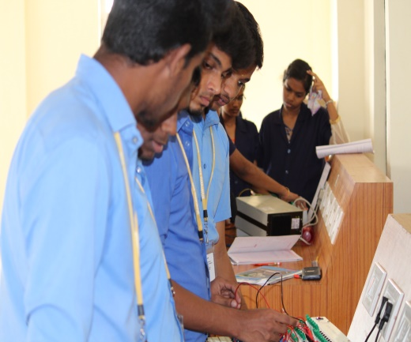
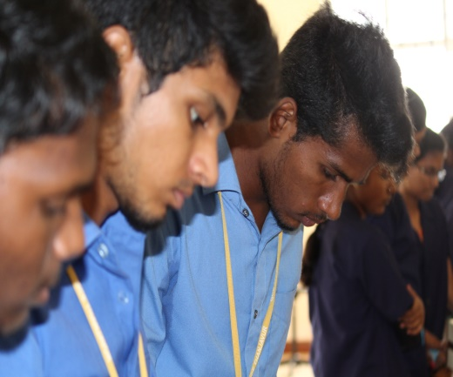
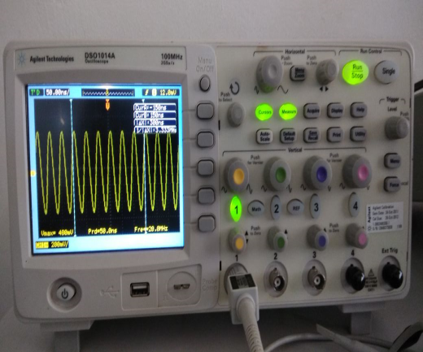
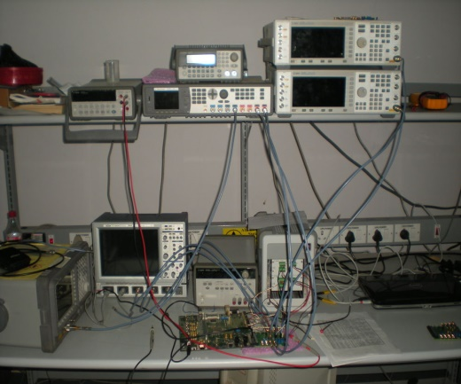
LABORATORY

Slide 10






LABORATORY
Electronic Circuits Laboratory
Function generator,CRO,
Dual Power Supply ,DSO,
Decade inductance,DRB,DRC
Linear Integrated Circuits Laboratory
OP-Amp,Analog IC Trainer kit,
Digital IC Trainer Kit,
Multimeter,IC tester,Power supply
Digital Signal Processing Laboratory
TMS320C541X,
Interfacing device,MATLAB,
C50 debugger
Microprocessor & Microcontroller Laboratory
8086 Trainer kit,8051 Trainer kit,
8085 Trainer kit
VLSI Design Laboratory
FPGA,Cool Runner,
Xilinx, VHDL
Embedded Laboratory
CORTEX, LPC2148,ARM7 WinXTalk, Flash magic
Keil software IAR Embedded Workbench,

Slide 11
PLACEMENT & TRAINING ACTIVITIES
Internship on Web development & AI
(Tech Saksham)
Business Intelligence Project Management and Data Visualization
(Ramanathan-Accenture)
(online training)
Quantitative Aptitude & Communication skills
(Venkatesan – Fifth wheel)
CRO/Digital CRO/Advance communication
(By Tektronix)
Computer Hardware Assembly
(By Industrial experts)

Slide 12
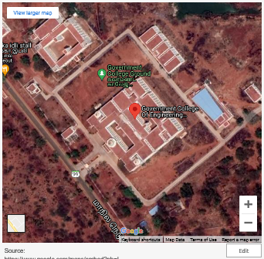
LOCATION

Slide 13



THANK YOU

